Slide 1
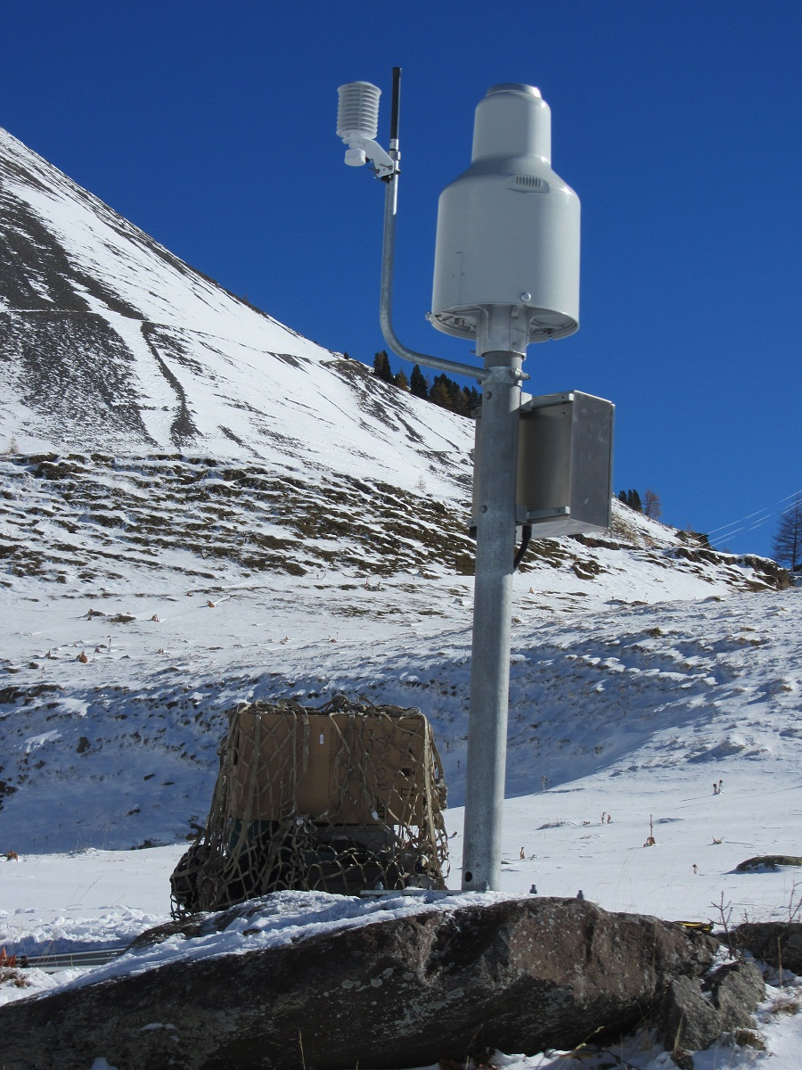
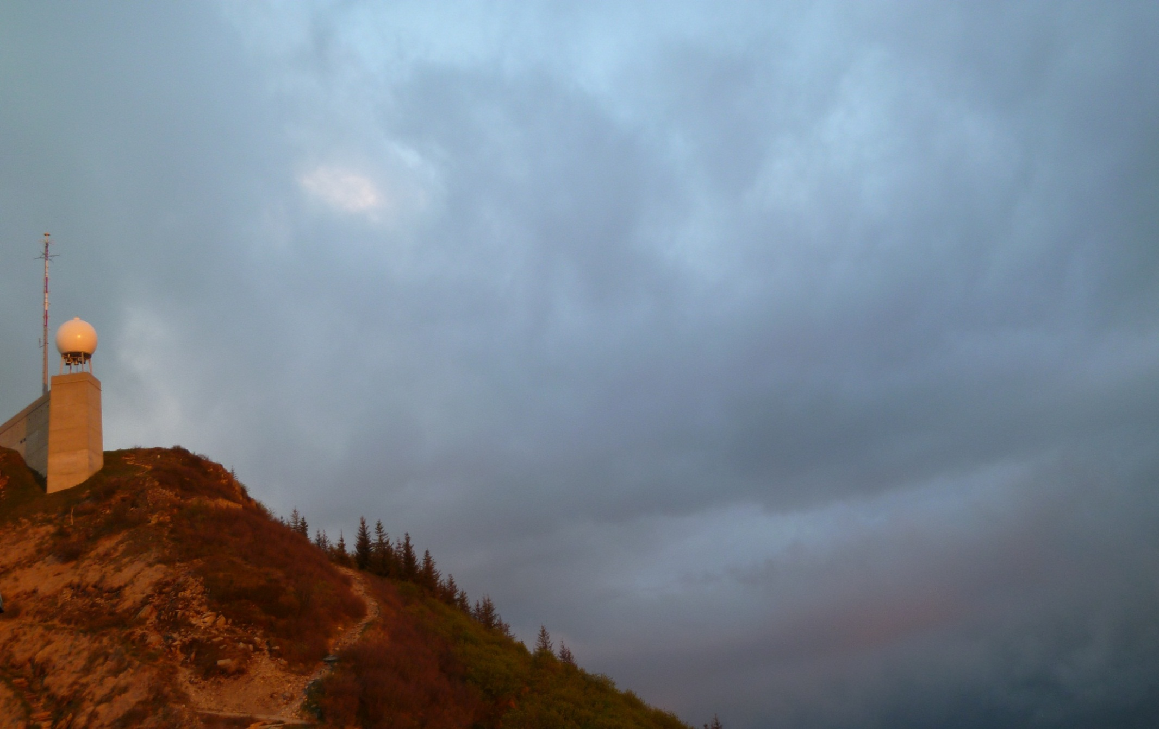
The role of
measurement technology,
data integration and nowcasting
for DRR in Switzerland
Urs Germann
Head of Radar, Satellite and Nowcasting Division
Project manager Rad4Alp (Swiss radar renewal)
MeteoSwiss, Locarno-Monti
Acknowledments: M Kube, E Grüter,
Y Roulet, L Panziera, I Sideris,
M Gabella, M Boscacci,
L Nisi, A Hering,
and others

Slide 2
Canton Glarus/Swiss Alps, 2009
15 July, 14:30: early warning for heavy precipitation
17 July, 05:00:
COSMO-7km forecasts peak of 150 m3/s on 18 July noon
COSMO-2km forecasts peak of 530 m3/s on 17 July eve
(critical if runoff exceeds 200 m3/s)
What do you do?
In reality peak reached 195 m3/s …
Situation has been managed perfectly by local authority. The critical decisions were taken at last minute and based on real-time radar and runoff measurements and nowcasting.

Slide 3
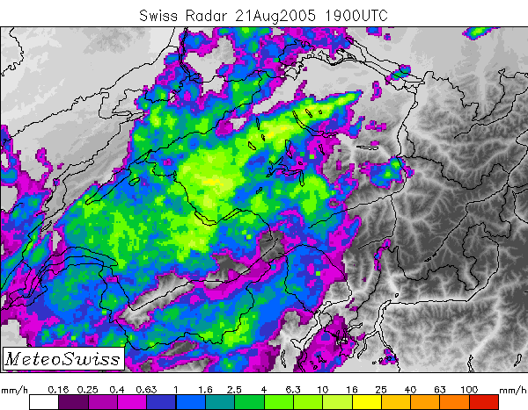
August 2005: Major flood in Switzerland
6 fatalities, damages of 3 billions CHF.
«Remarkable» says the radar expert excited
knowing how difficult it is to get radar fields of this quality in a mountainous region,
«useless» the hydrologist
being completely disappointed by the 50% underestimation.

Slide 4
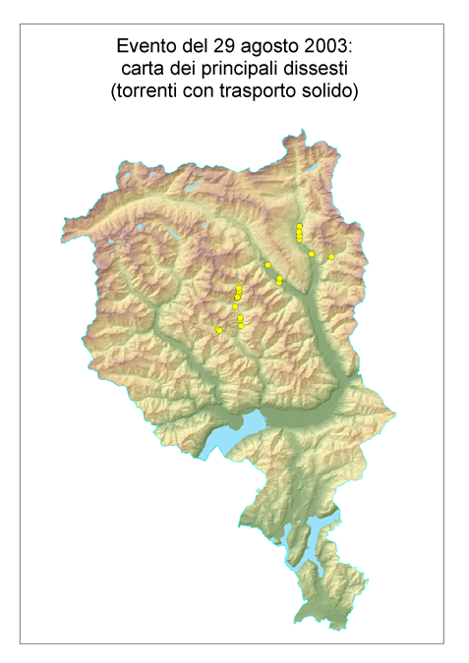
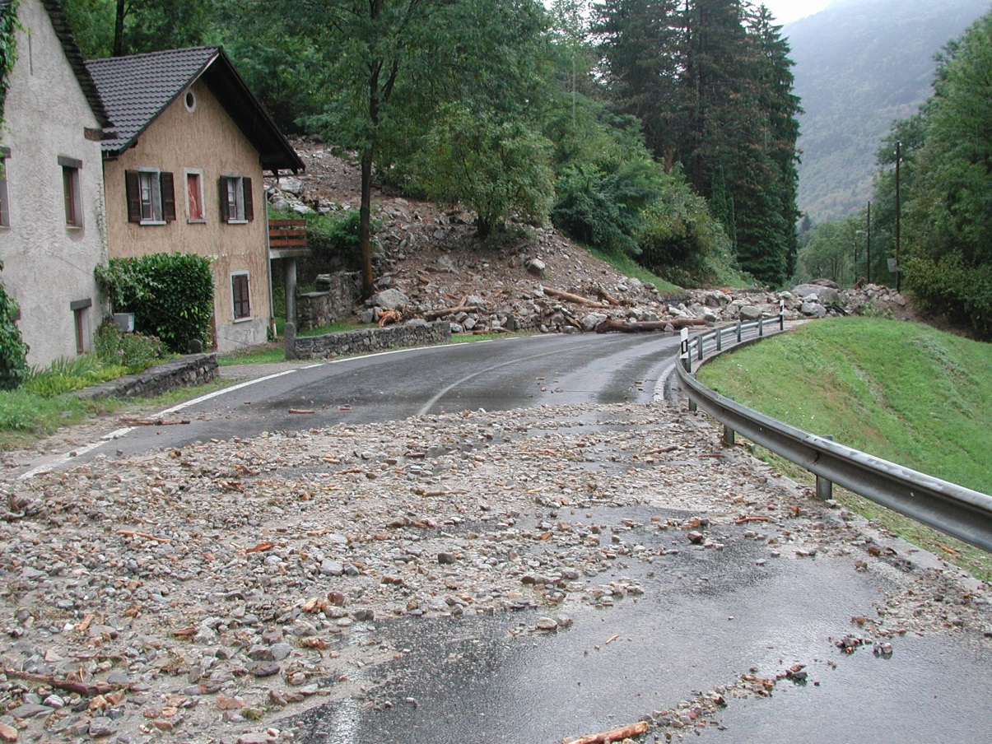
We know there is large potential !
29 August 2003
80 km
Isolines: Radar
Accumulation
4 most intense
hours
debris flow
(Canton TI)
100 mm
Val Blenio (Foto G Valenti)

Slide 5
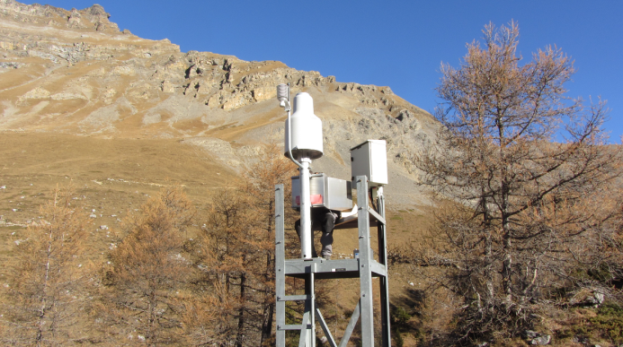
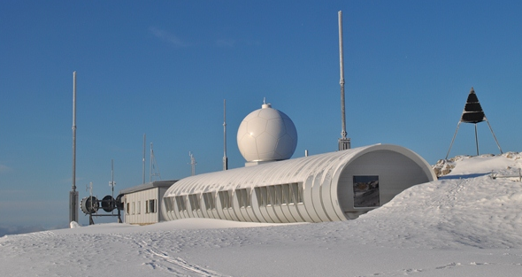
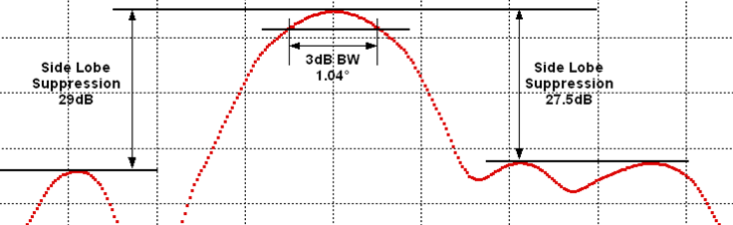
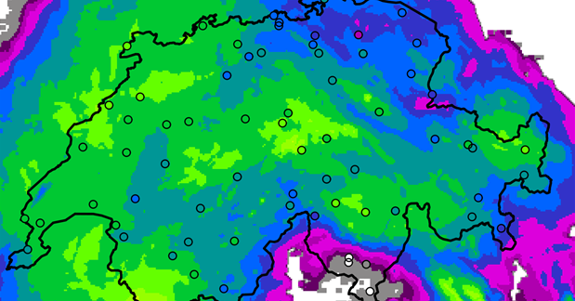
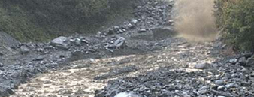
Ground measurements
Weather radars
Data integration
Uncertainty
Research
The full chain

Slide 6
SwissMetNet VSSFE
Salanfe, 1924m
Part 1 Ground measurements:
A representative station for every warning region

Slide 7
Goals of network extension
Increase density of stations
Get representative measurements in all warning regions: gap filling
Automatization of 135 raingauge stations
Integrate quality-checked stations from other network operators («Partnernetze»)
Build new stations where no other station is available
Modernization of existing raingauge stations
Finalisation of the raingauge network of project «Canton of Valais»
(project SwissMetNet III, project SwissMetNet II, project Canton Valais)

Slide 8
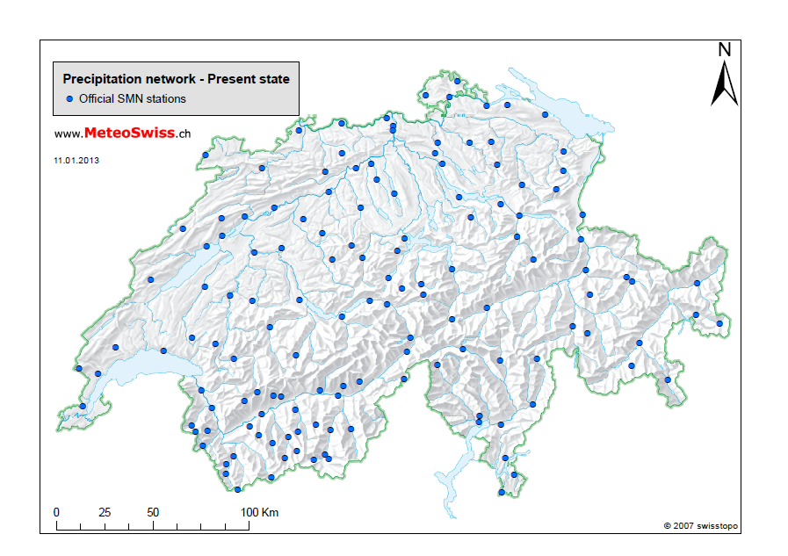
Today: 142 automatic SwissMetNet stations

Slide 9
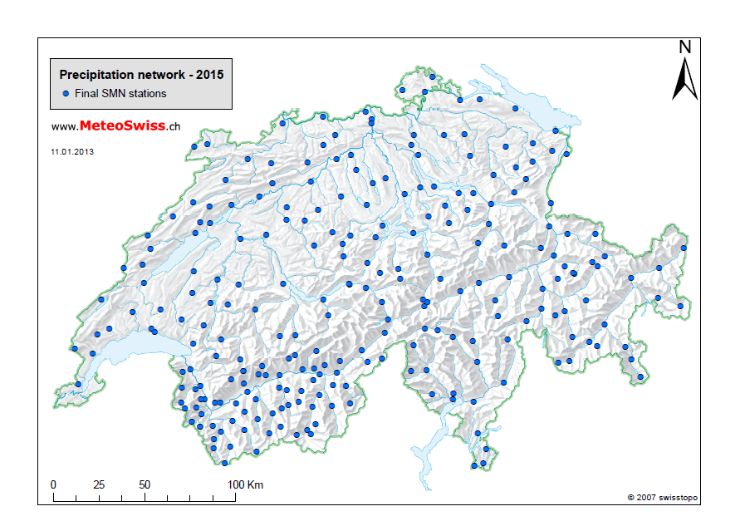
2015: 253 automatic SwissMetNet stations

Slide 10
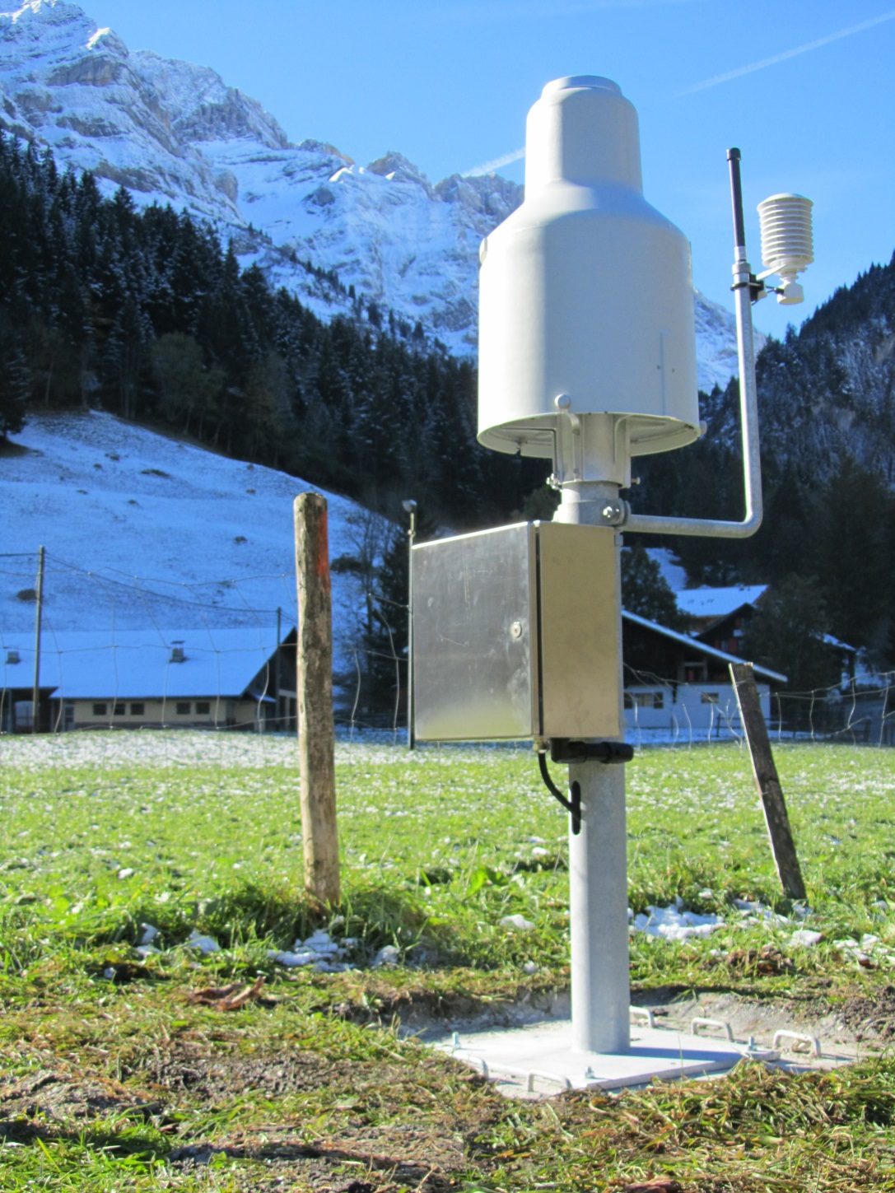
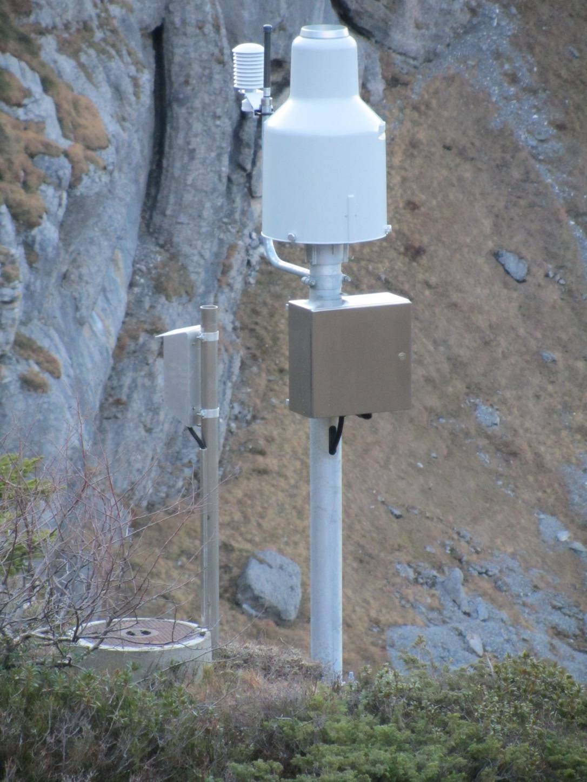
Canton of Valais network
SwissMetNet VSCHY
Champéry
SwissMetNet VSCLU
Clusanfe, 1901m

Slide 11
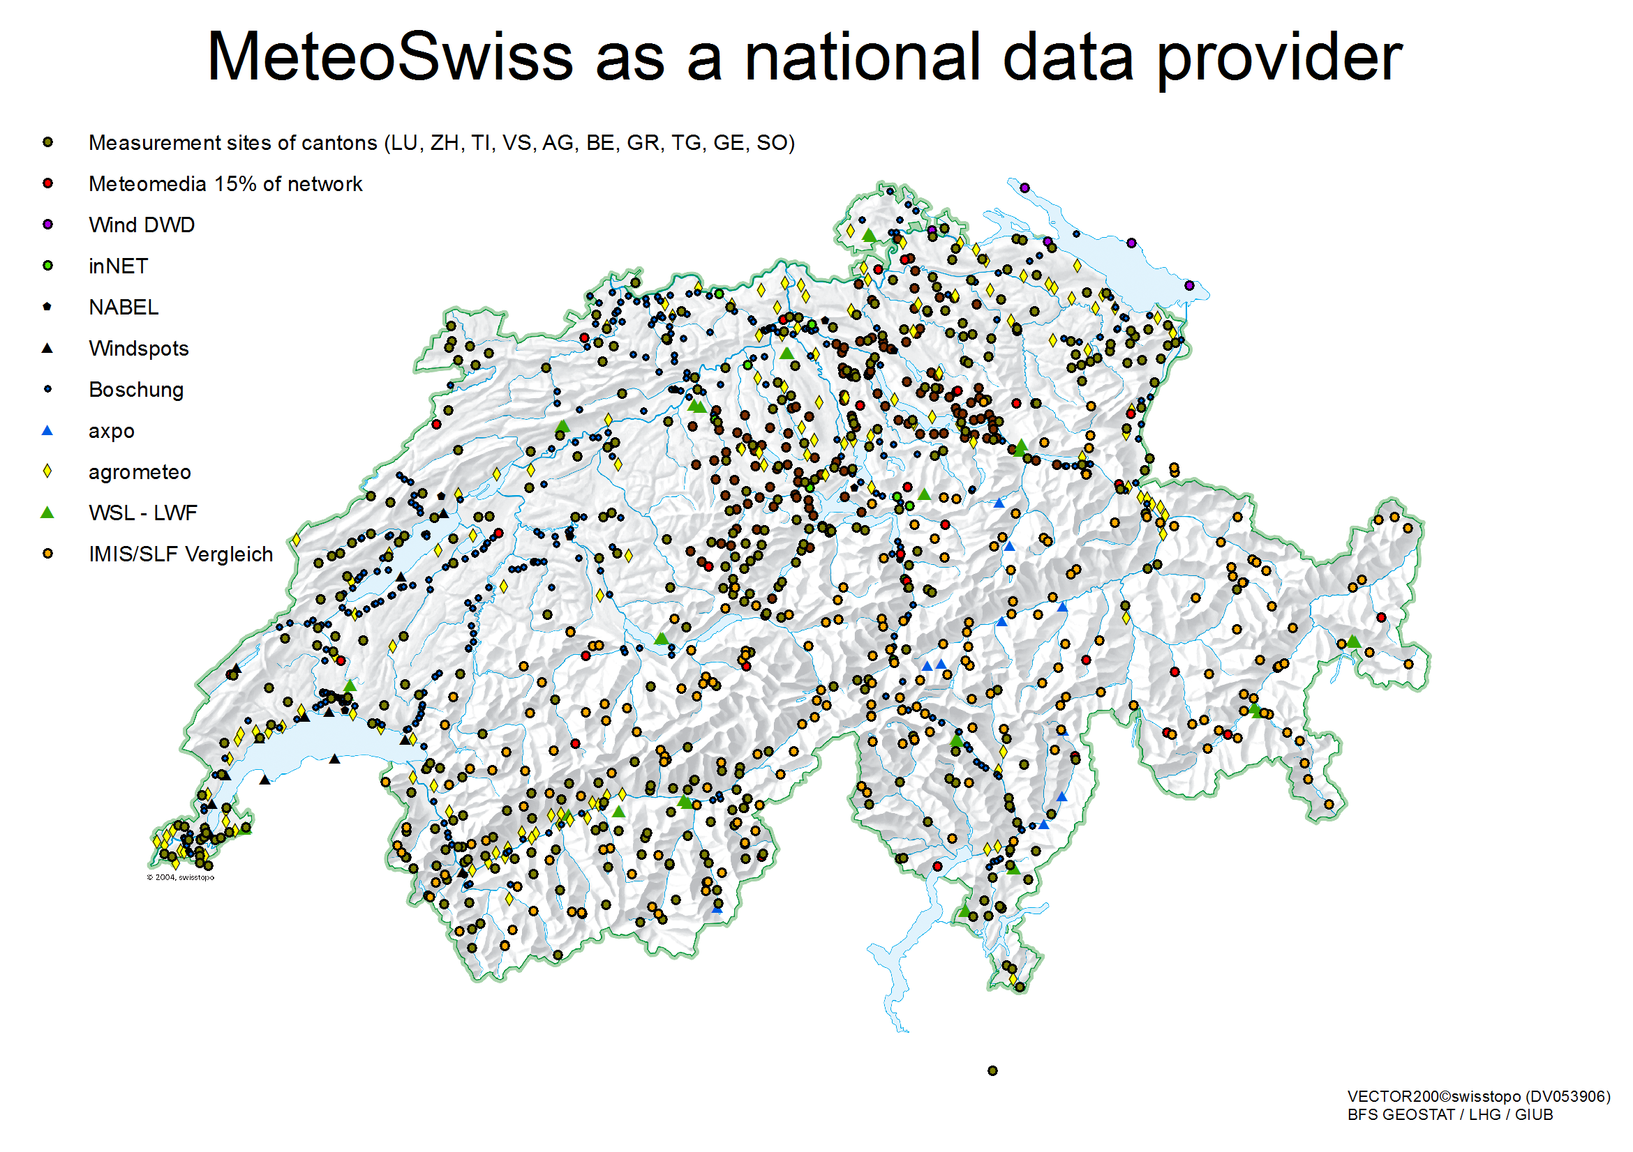
3rd partner networks

Slide 12
Integration of 3rd partner networks
→ Forms of partenariats
Forms of partenariats:
  MeteoSwiss as partner station provider and maintainer: Construction, management and maintenance of partner stations → the partner only wants the data but no responsibility for maintaining the network
    Sites are chosen and realized following WMO Guidelines and manuals
    quality control mechanisms are based on WMO guidelines
  MeteoSwiss as data host
  Integration and hosting of partner data inclusive QC
    quality control mechanisms based on WMO guidelines and regulations.
  MeteoSwiss as data deliverer and data user
  Integration for delivery to the Swiss common platform for natural hazards and/or to ameliorate our products.
    Only data integration => Problem → unknown data quality!

Slide 13
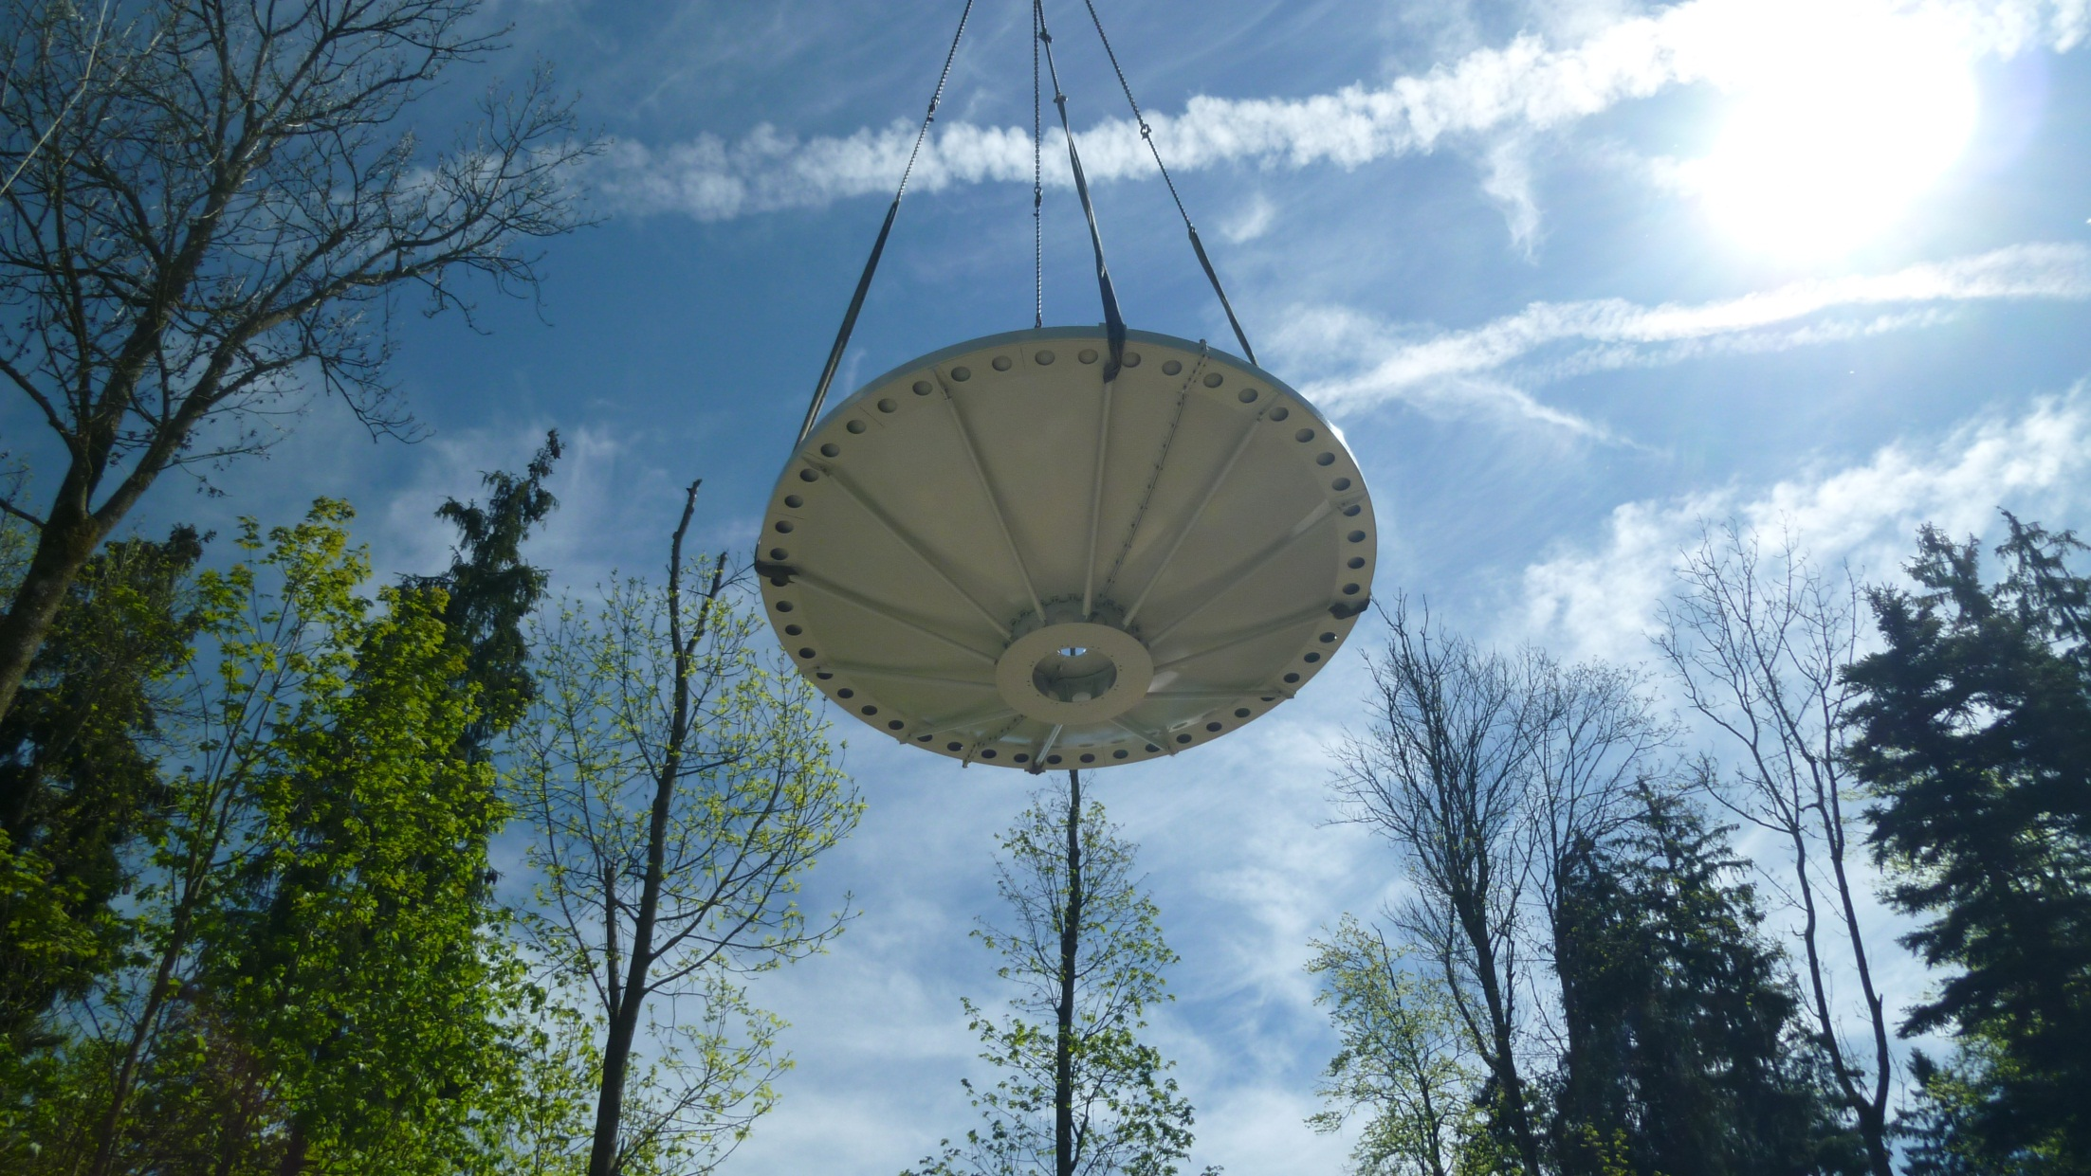
Radar Albis, near Zurich, 925m
Part 2 Weather radar:
Design driven by natural hazards

Slide 14
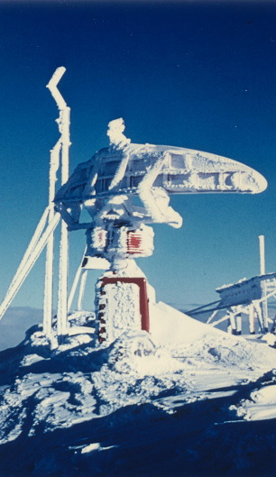
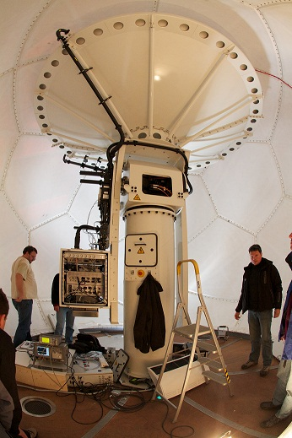
1st generation 1961
4th generation 2011

Slide 15
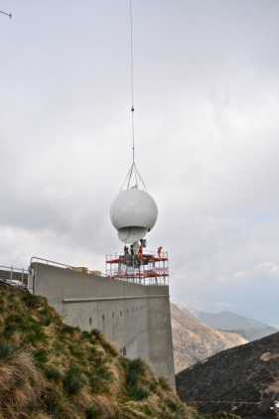
Swiss radar history
Backbone for
heavy precipitation alert
thunderstorm warnings
flash flood warnings
civil protection
5 radars
Doppler, Dual-polarisation
many customers, many products
Integrated end-to-end forecast chains
international networking
applied research
3 radars
Doppler
2 radars
1 customer
1 product
analog
stand-alone
digital
1961
1977
1993
now
1st generation
2nd generation
3rd generation
4th generation

Slide 16
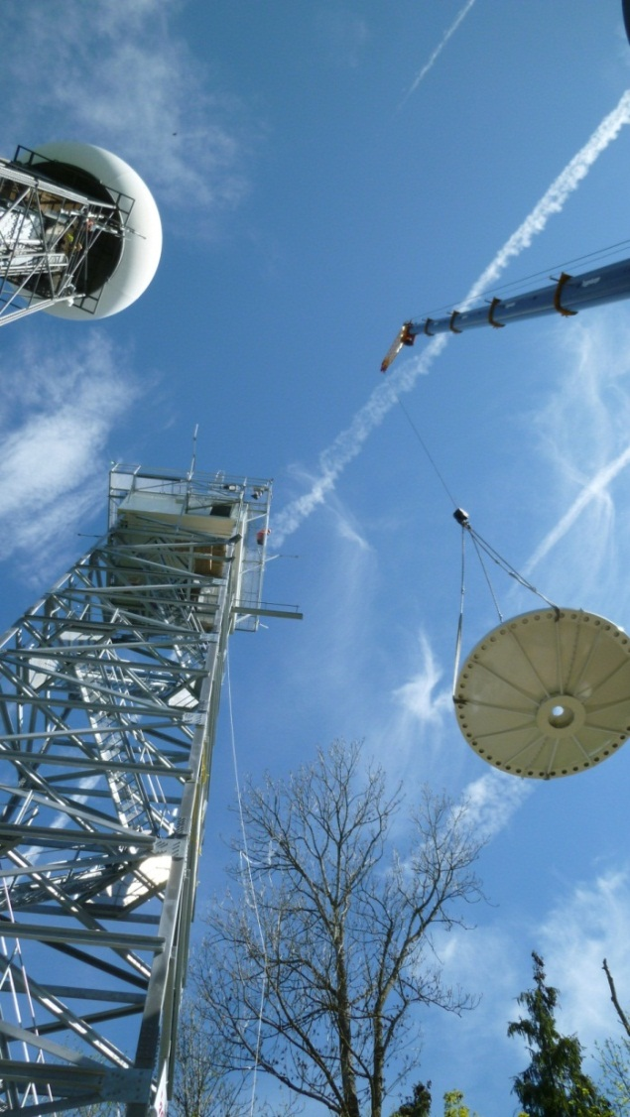
Design driven by needs to better nowcast natural hazards
Add 2 sites to improve coverage in the Alps
Add dual-polarisation technology to improve data quality and get hydrometeor identification
Renew data processing and get source codes to get high flexibility for research and rapid response to emerging user needs
Design data processing such that we get all products within 60 seconds
Increase vertical coverage to improve monitoring of thunderstorms
Mount receiver on reflector to gain sensitivity
Refine scan strategy to get full 3D volume and rapid update (20 sweeps in 5 minutes!)
Update all products every 2.5 minutes
Send raw data to central server to improve compositing
(…)

Slide 17
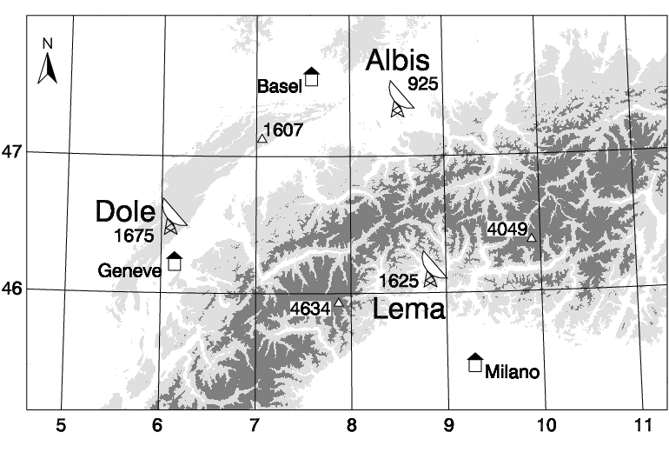
Inneralpine coverage and backup
Weissfluh
Plaine Morte

Slide 18
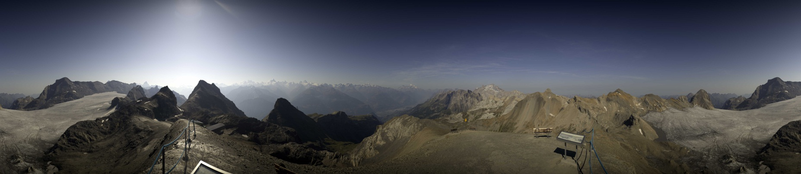
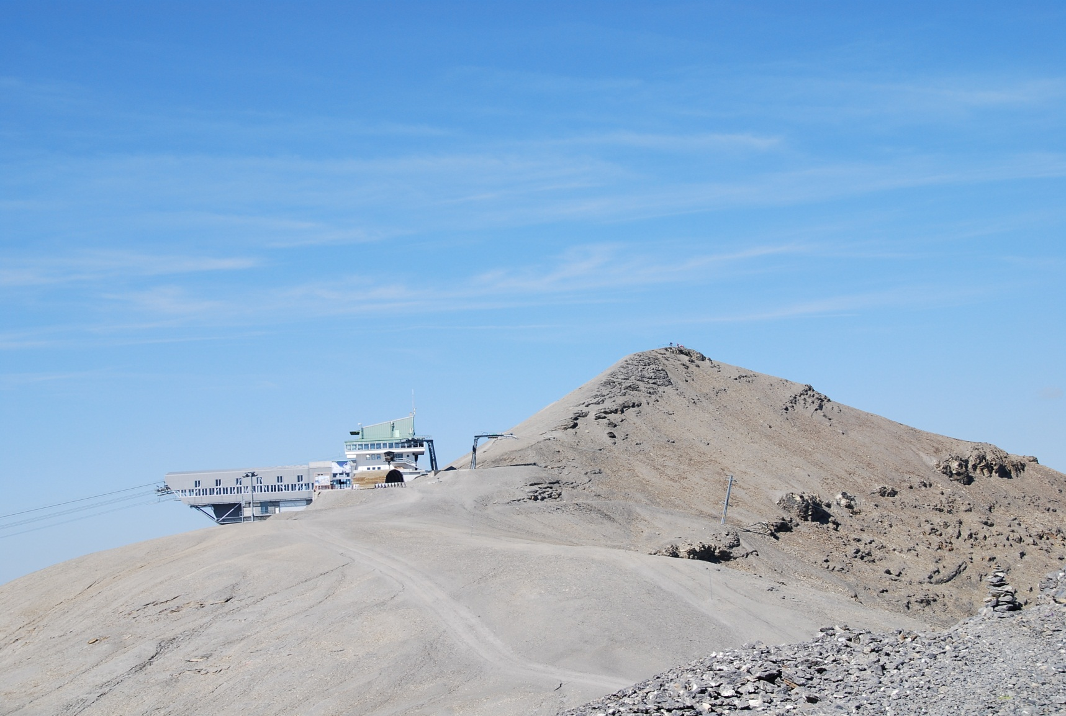
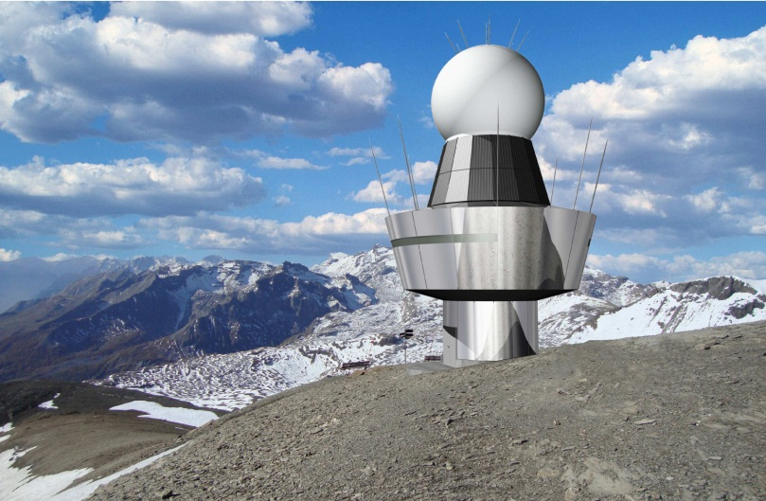
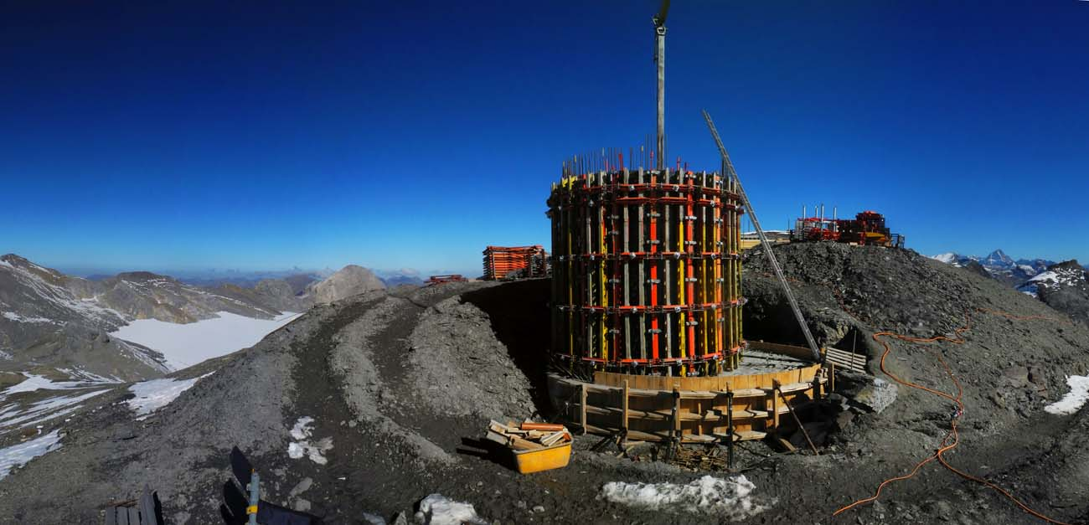
New site in Valais: Pointe de la Plaine Morte
E
S
W
N
Wildstrubel
Goms
Sierre
Sion
Léman
Bern
View towards Valais (VS)
31.10.12
How it will look like

Slide 19
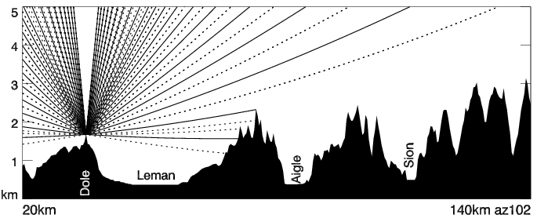
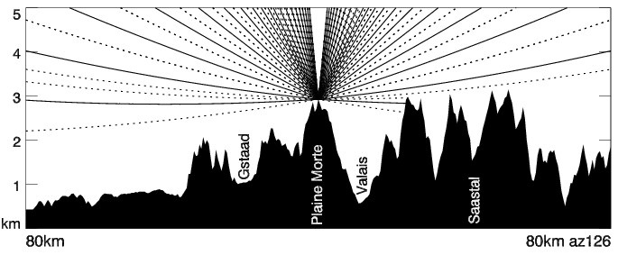
Alps as seen from Dole and Plaine Morte
Existing
radar
on
Dole
New radar
on
Plaine Morte

Slide 20
SwissMetNet VSSFE
Salanfe, 1924m
SwissMetNet VSSOR
Sorniot, Lac Inférieur, 2005m
Radar Monte Lema, 1625m
Part 3 Data integration:
The key to get better nowcasts

Slide 21
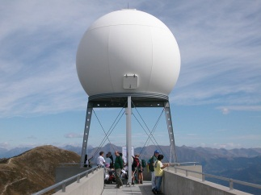
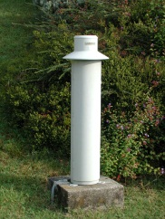
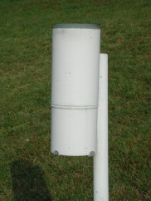
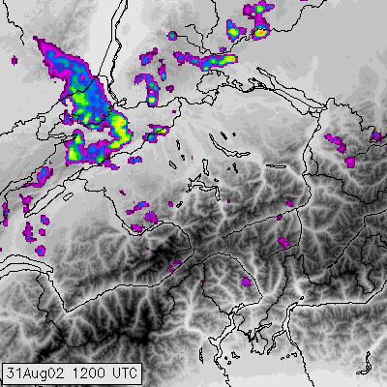
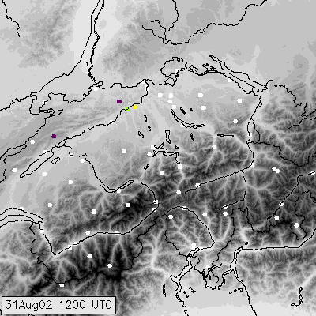
Radar and raingauge are complementary
1 Radar
69 Gauges
300 km

Slide 22
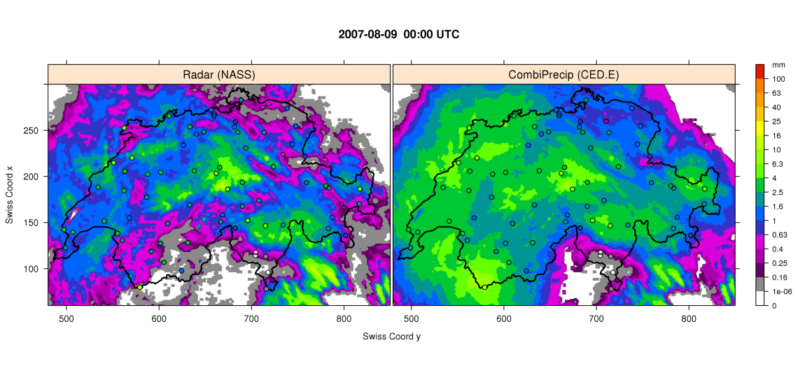
Real-time radar-raingauge merging
Radar-only
Real-time radar-raingauge merging
Technique: Co-kriging with external drift
with data transformation and
sophisticated quality control

Slide 23
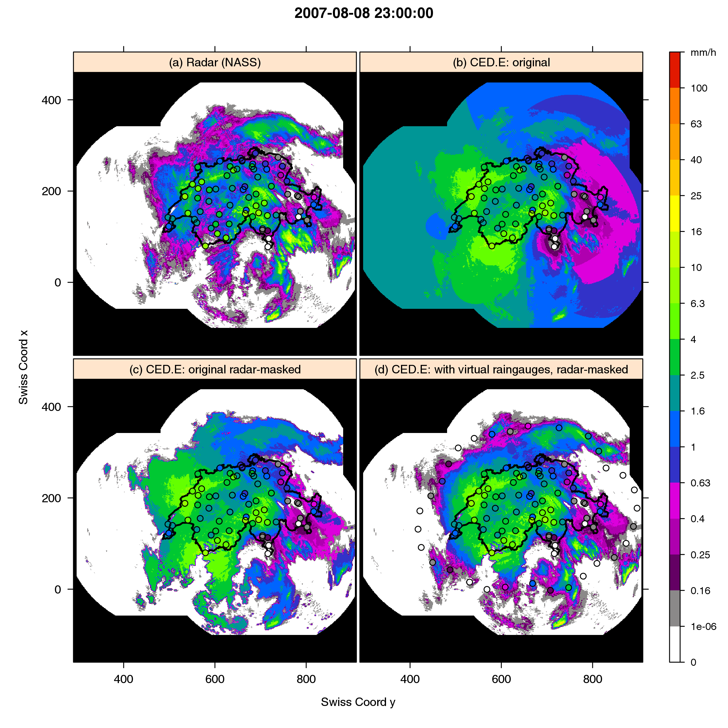
Extrapolation
Of course, in parallel, we are also in contact with neighbouring countries to extend trans-border data exchange!

Slide 24
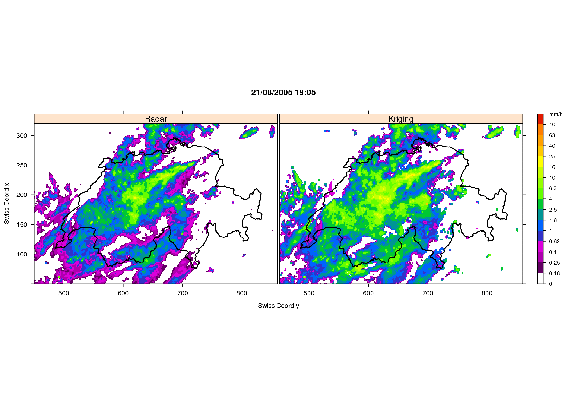
Real-time radar-raingauge merging
Radar-only
Real-time radar-raingauge merging
-0.8 Bias/dB (best is 0.0) -0.08
2.7 SCATTER/dB (best is 0.0) 2.2 (evaluated at hourly scale, pooling 12 representative events)
Sideris, Gabella, Erdin, Germann (QJRMS, 2013)

Slide 25
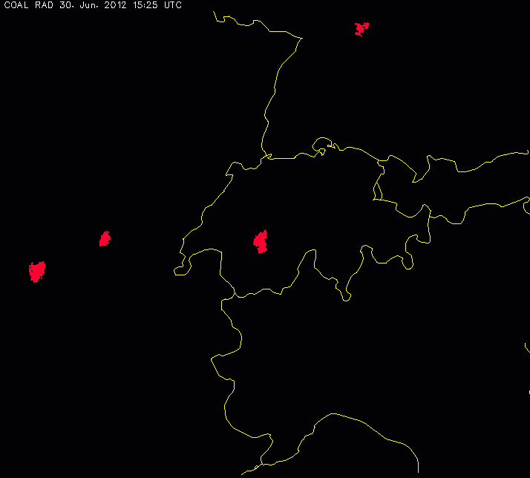
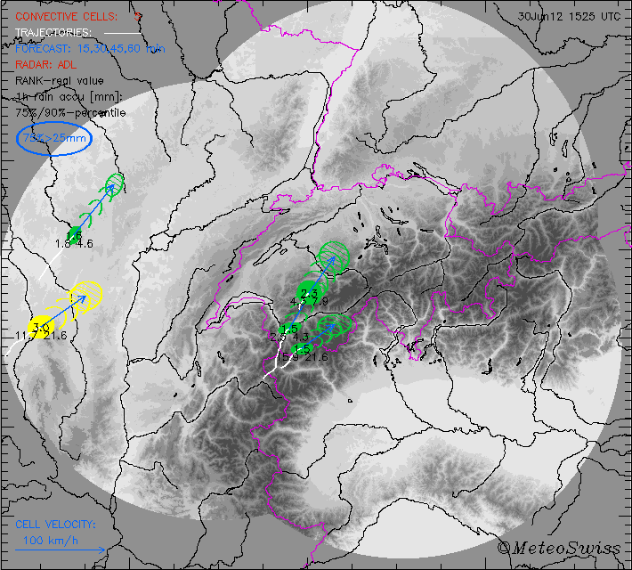
Multi-sensor thunderstorm nowcasting at MeteoSwiss (Hering, Nisi, Ambrosetti, et al)
COALITION early detection of developing severe cells:
TRT: detection and classification of thunderstorm cells:
severe thunderstorm in the next 30 min
severe thunderstorm
moderate thunderstorm
thunderstorm intensification in the next 30 min
weak thunderstorm

Slide 26
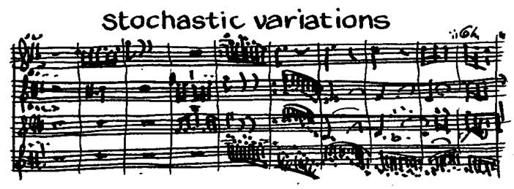
Part 4 Uncertainty
Living with uncertainties

Slide 27
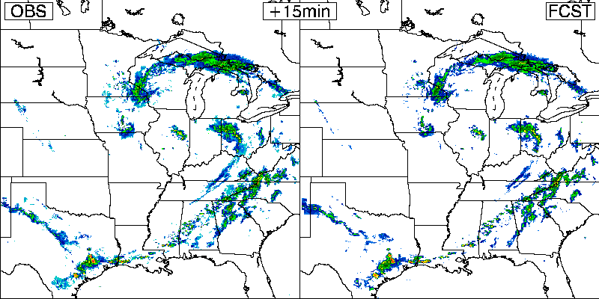
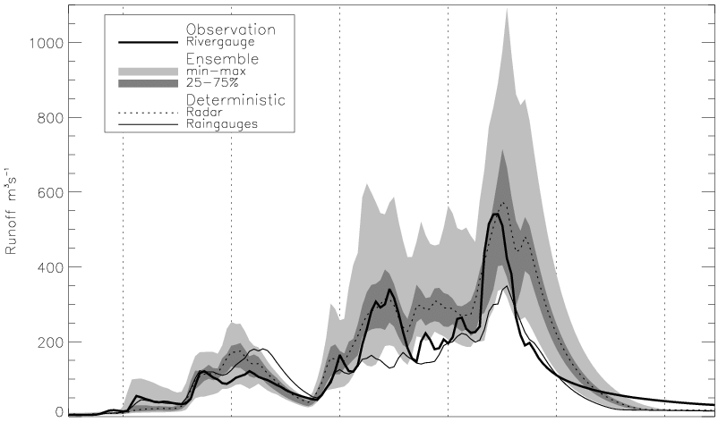
Uncertainty propagation
observing
forecasting
QPE = quantitative precipitation estimation
QPF = quantitative precipitation estimation
Immediate past
now
Immediate future
?
QPE
?
Ref
QPF
Radar QPE error structure
Precip
model
?
?
?
Runoff fcst
Runoff
model
QPF model error structure
+
?
?
?
Radar QPF error structure
+
+

Slide 28
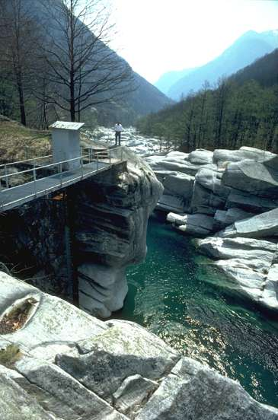
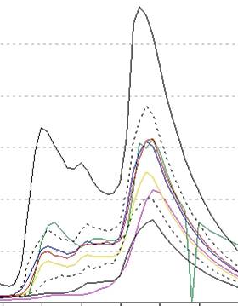
Radar ensemble for runoff modeling
Goal:
import radar precipitation field into runoff model and keep track of uncertainties
Radar
ensemble
vary slightly
Ensemble of runoff
Radar precipitation field
?
Runoff
model
100 m³/s
50 m³/s
Time

Slide 29
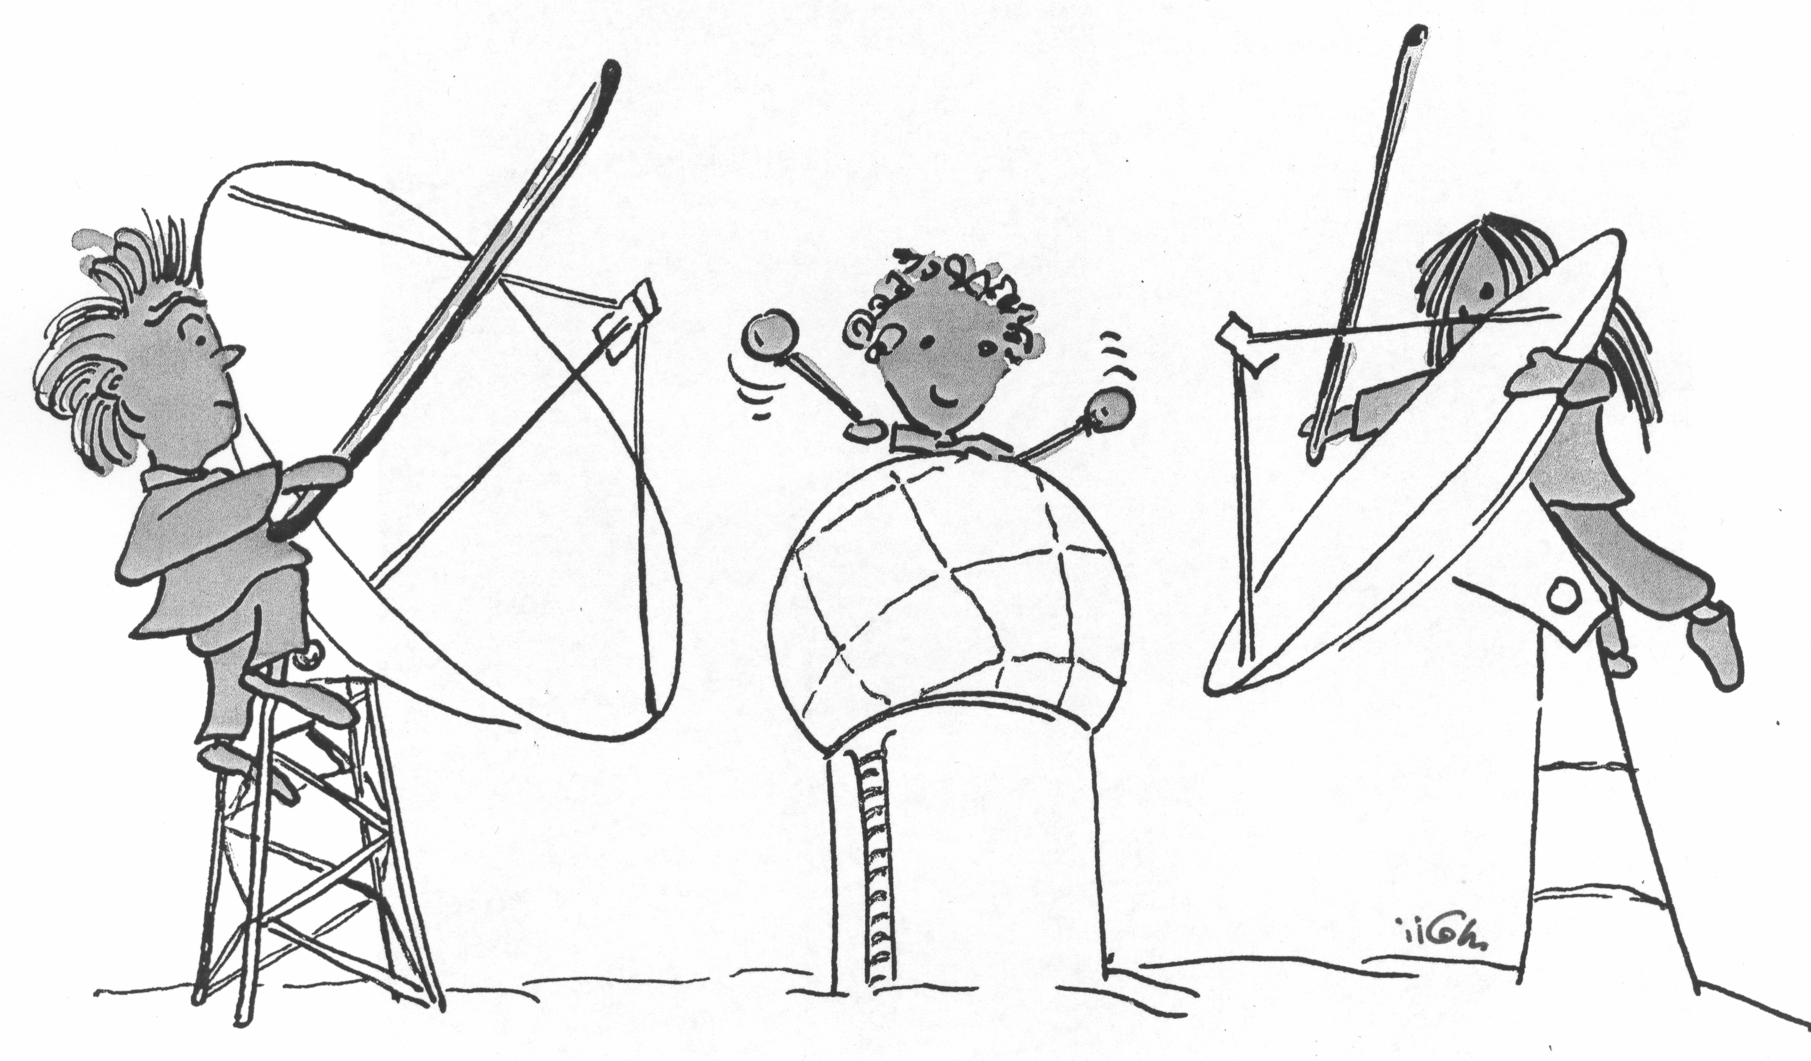
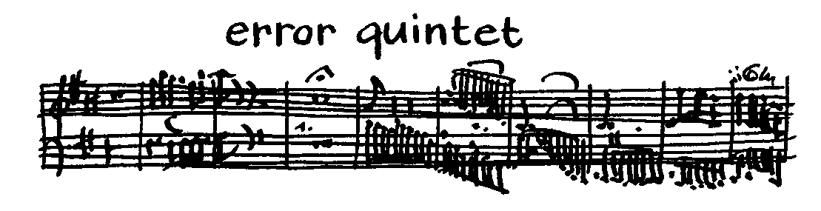
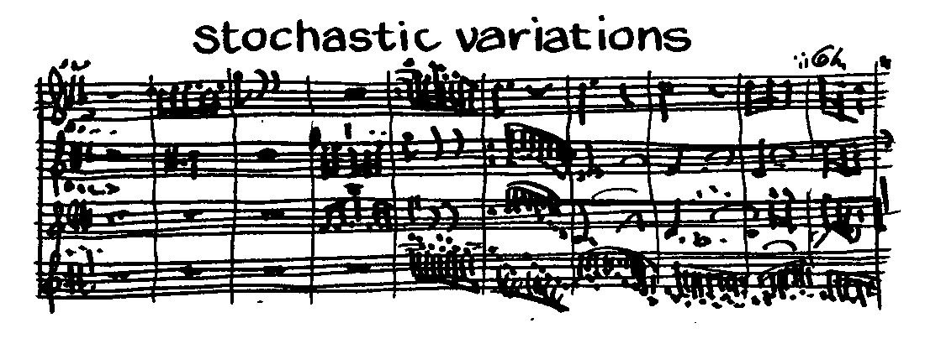
Radar ensemble

Slide 30
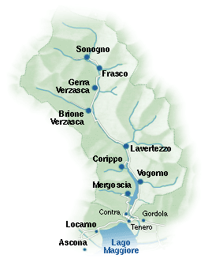
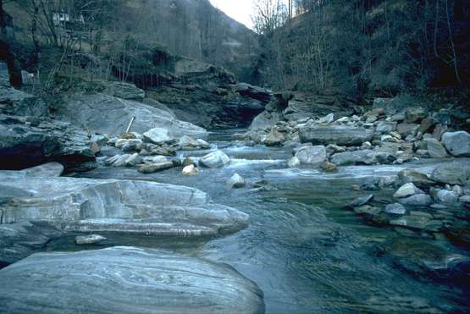
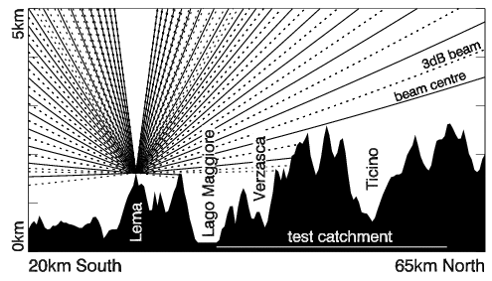
Radar ensemble: Real-time implementation
FOEN
rivergauges
As far as we know
1st
real-time experiment worldwide
coupling radar ensemble with runoff model.
Forecast system is running
since May 2007.
2864m
Pincascia
Lavertezzo
44km²
Verzasca
Lavertezzo
186km²
Cross section of radar scan
193m
automatic
raingauges
10 km
Germann et al. (QJRMS, 2009)

Slide 31
Part 5 Research
The role of research in DRR

Slide 32
Recent research related to natural hazards
of the Radar, Satellite Nowcasting Division
2005-2010, COST-731: European concerted research action on uncertainty propagation in advanced hydro-meteorological forecast systems
2006-2009, MAP D-PHASE: WMO FDP forecast demonstration project on probabilistic hydro-meteorological forecasting
2007-2010, PROFIT: Swiss NF research project on nowcasting of intense orographic rainfall
2009-2012, COALITION: EUMETSAT research fellowship on multi-sensor thunderstorm nowcasting
2009-2012, IMPRINTS: European FP7 research project on flash flood and debris flow forecasting
2009-2012, CombiPrecip: MeteoSwiss research project on radar-raingauge integration for real-time rainfall mapping
… and several others (ACQUIRE, SAF/NWC, …)

Slide 33
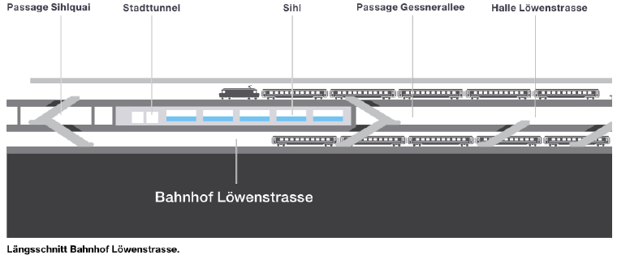
Part 6 The full chain
down to the end user

Slide 34
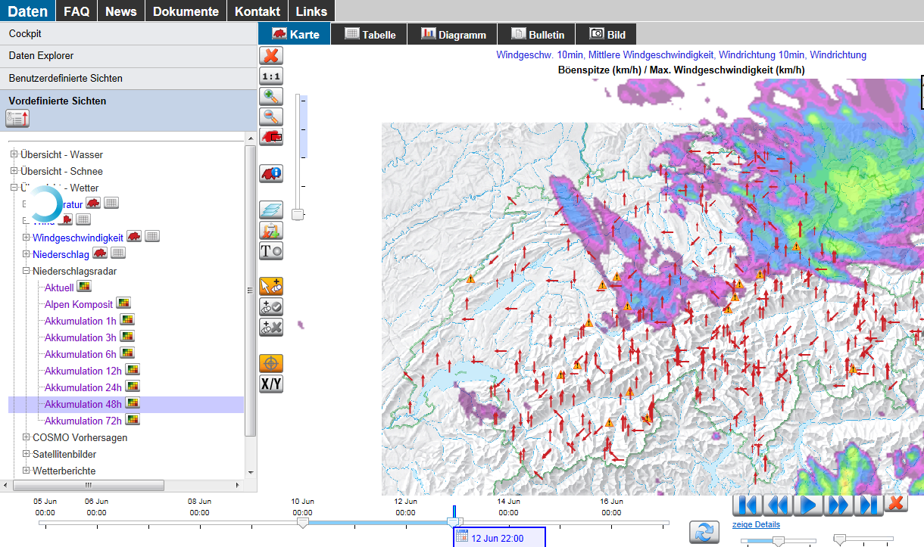
Information platform natural hazards (GIN)

Slide 35



Radar nowcasting for gas pipeline
15.12.10: Meeting with customer for part “radar”
17.12.10: 1st configuration and login web platform
23.12.10: 1-day training
24.12.10: Customized radar alert system operational
24.12.10: Re-opening of pipeline
(…)
2011: Detailed scientific analysis
29.05.12: Start new radar alert system “2012”

Slide 36

Radar alert for Landslide Valegión
FRI, 18 May 2012: Phone call from authority
MON, 21 May 2012: Phone conference
WED, 23 May 2012: Expert meeting
FRI, 25 May 2012: Access to online web platform with customized radar and INCA nowcasting services
Development of automatic alert system, inspired by experience from research project D-PHASE, IMPRINTS and other alert systems.

Slide 37
Railway station „Löwenstrasse“
Zurich

Slide 38
Thank
you

Slide 39



Lema, Dole
and Albis replaced
by completely new
Polarimetric Doppler
C-band systems
with ROEL design
Data processing refined.
Server architecture completely renewed.
Start construction of
2 additional radars
in VS and GR.
5 identical systems

Slide 40


Radar Albis
mounting the antenna
Radar Lema:
mounting the radome

Slide 41

From the Hyogo Framework for Action
“build the resilience of nations and communities to disasters”
“to identify, assess and monitor disaster risks and enhance early warning”

Slide 42

Understanding orographic rainfall
that leads to flooding of Maggia river
Maggia river in Solduno
926 km2, southern Switzerland
Typical runoff: 10 m³/s
About once in a year: >1000 m³/s
2006-2011 (6y)
Select events with 16 highest runoff.
Make 2 groups:
8 heaviest
rank 9-16
Panziera, James, Germann, submitted to QJRMS

Slide 43

Short-term forecasting of precipitation
Mandapaka, Germann, Panziera, Hering (2011)

